Slide 1
Problem Definition
By Elvis Kimara

Slide 2

Given a plant point cloud, how can we do G-verse, and have an accurate scalar value t, that represents an accurate lower dimension representation of that point cloud

Slide 3
Proposal

Slide 4
What we need to do
Step 1: Given a folder of 1400 point clouds, how can we sort them in a way such that order doesn’t matter. Preferably, similar point clouds closer to each other, and dissimilar ones farther away
Past ideas have included contrastive learning
Step 2: Given the sorted point clouds, how can we interpolate smoothly between each one of them
without using a linear interpolation function. (learn my own t value implicitly)
Using Lipschitz regularization
Step 3: Given a new point cloud, how can we feed it to our model such that a scalar t_value is returned. This will be the most similar interpolation to the new point cloud

Slide 5

Thank You

Slide 6
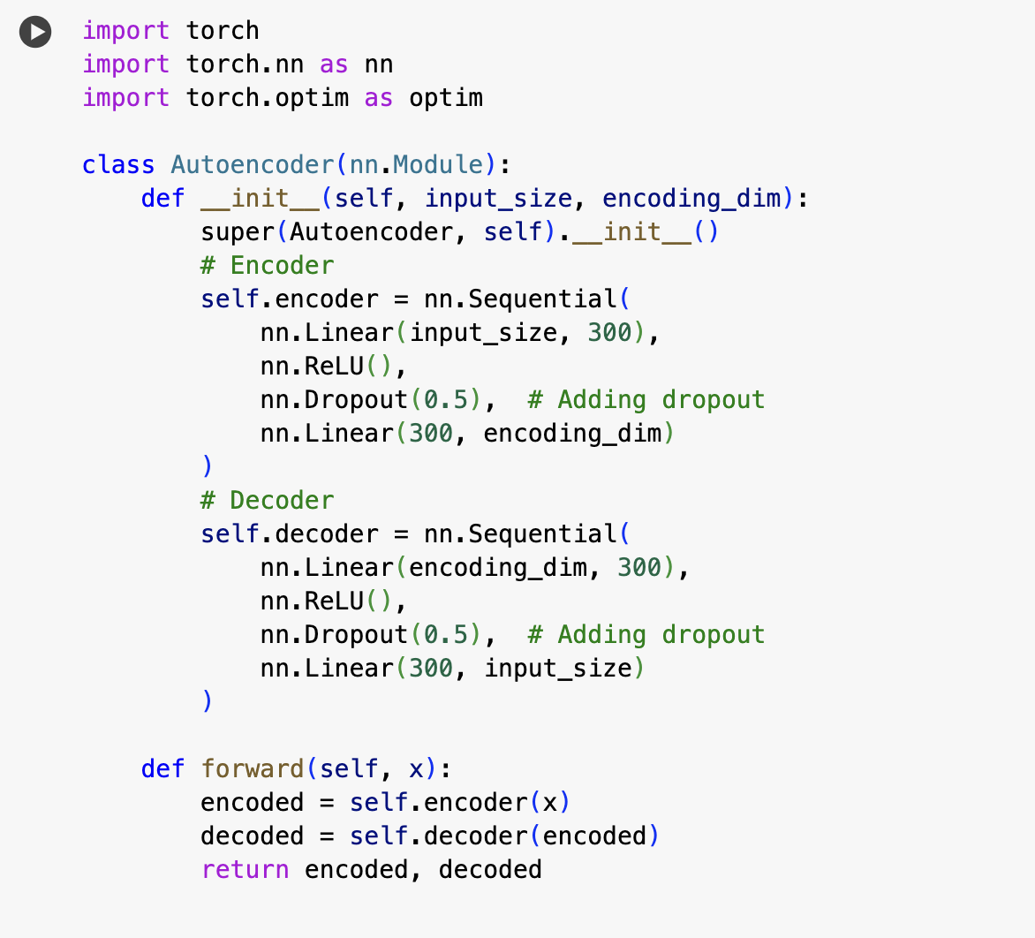
Part One

Slide 7
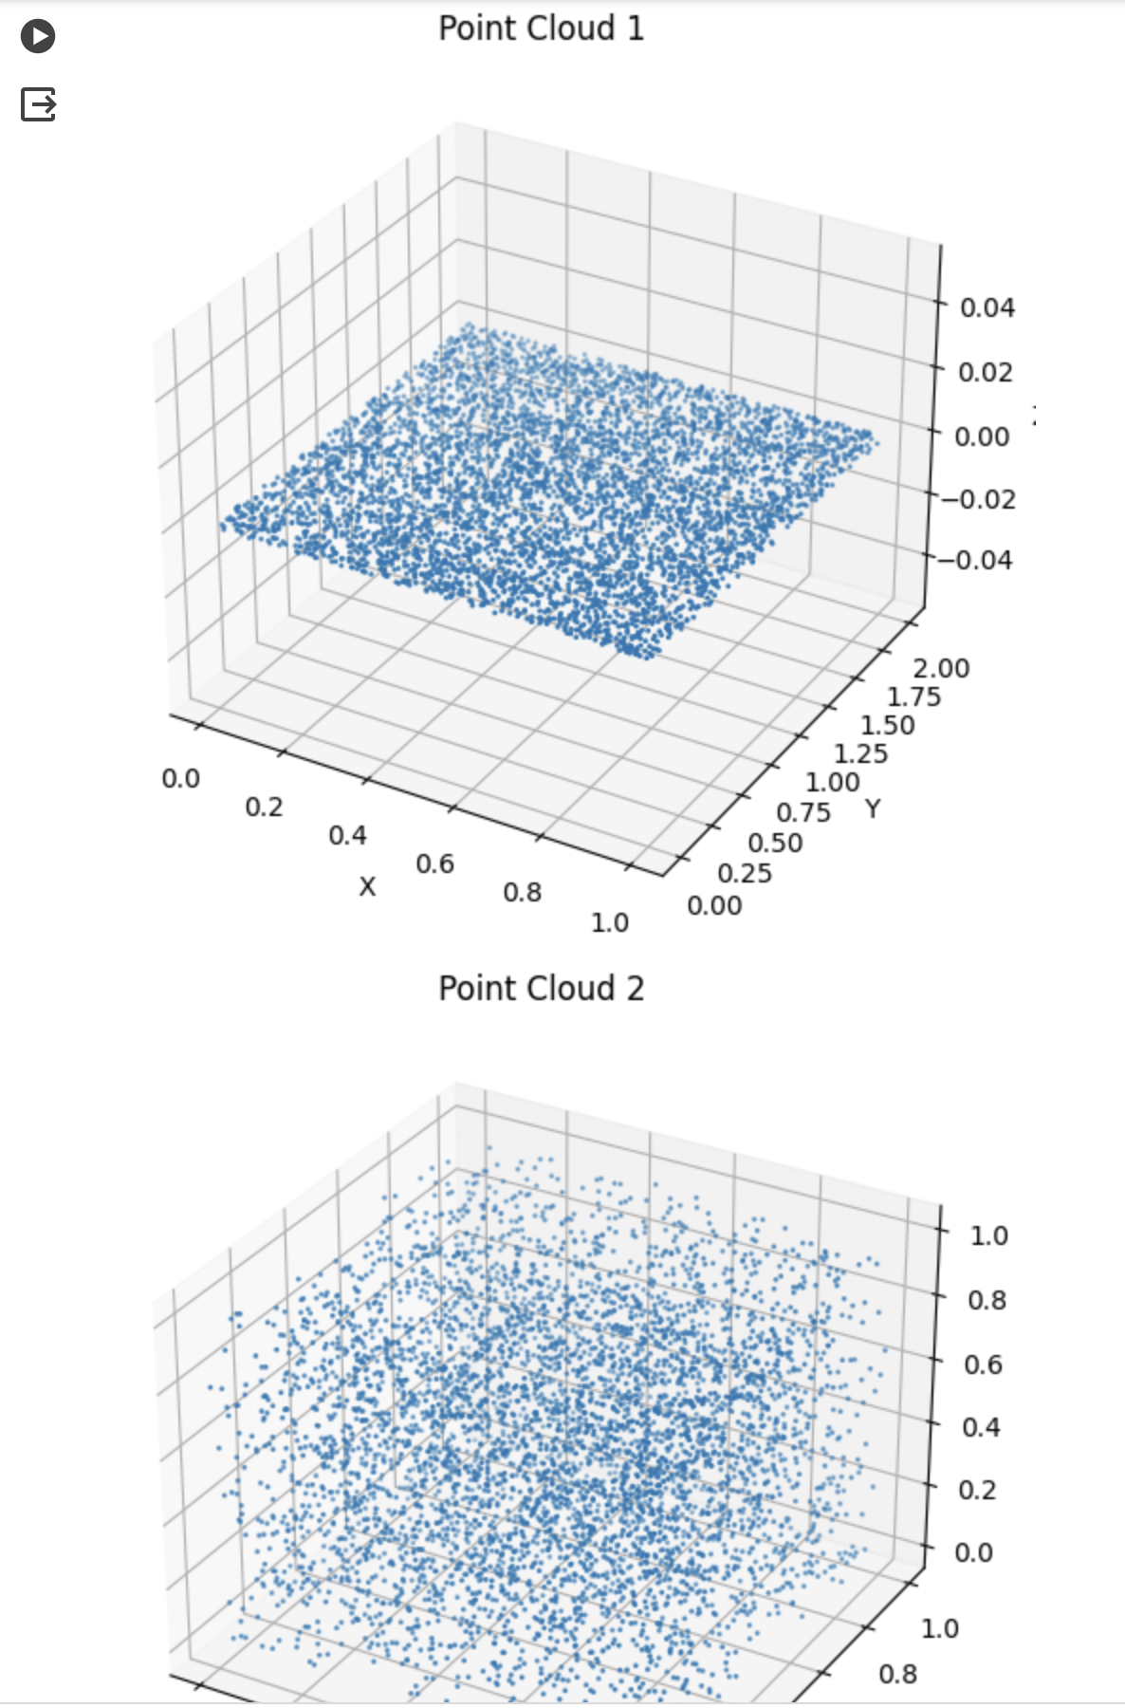
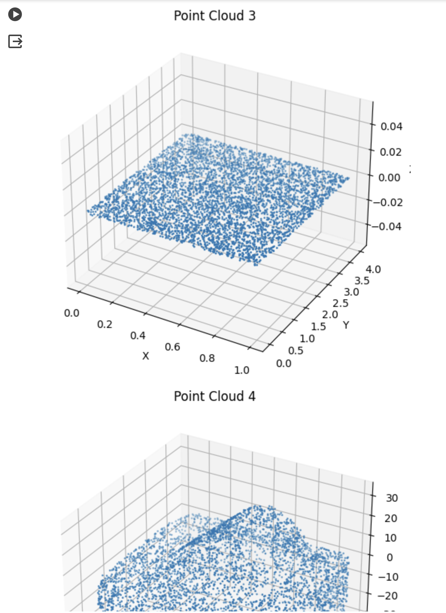
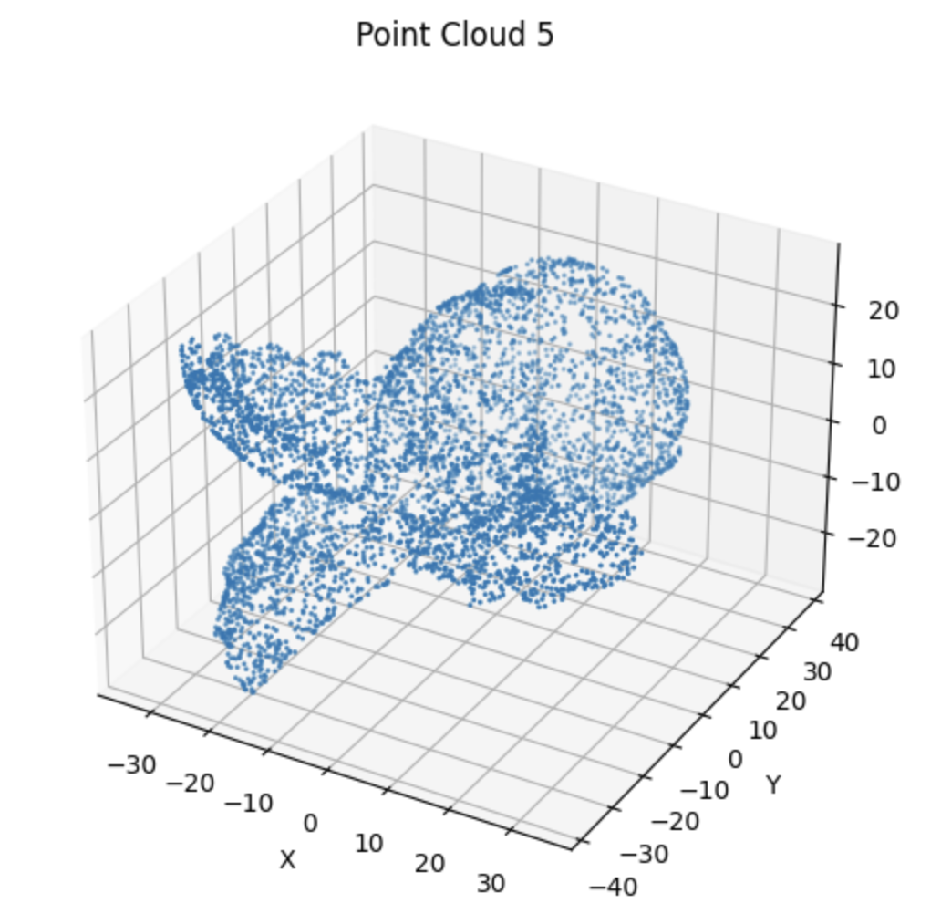

Slide 8
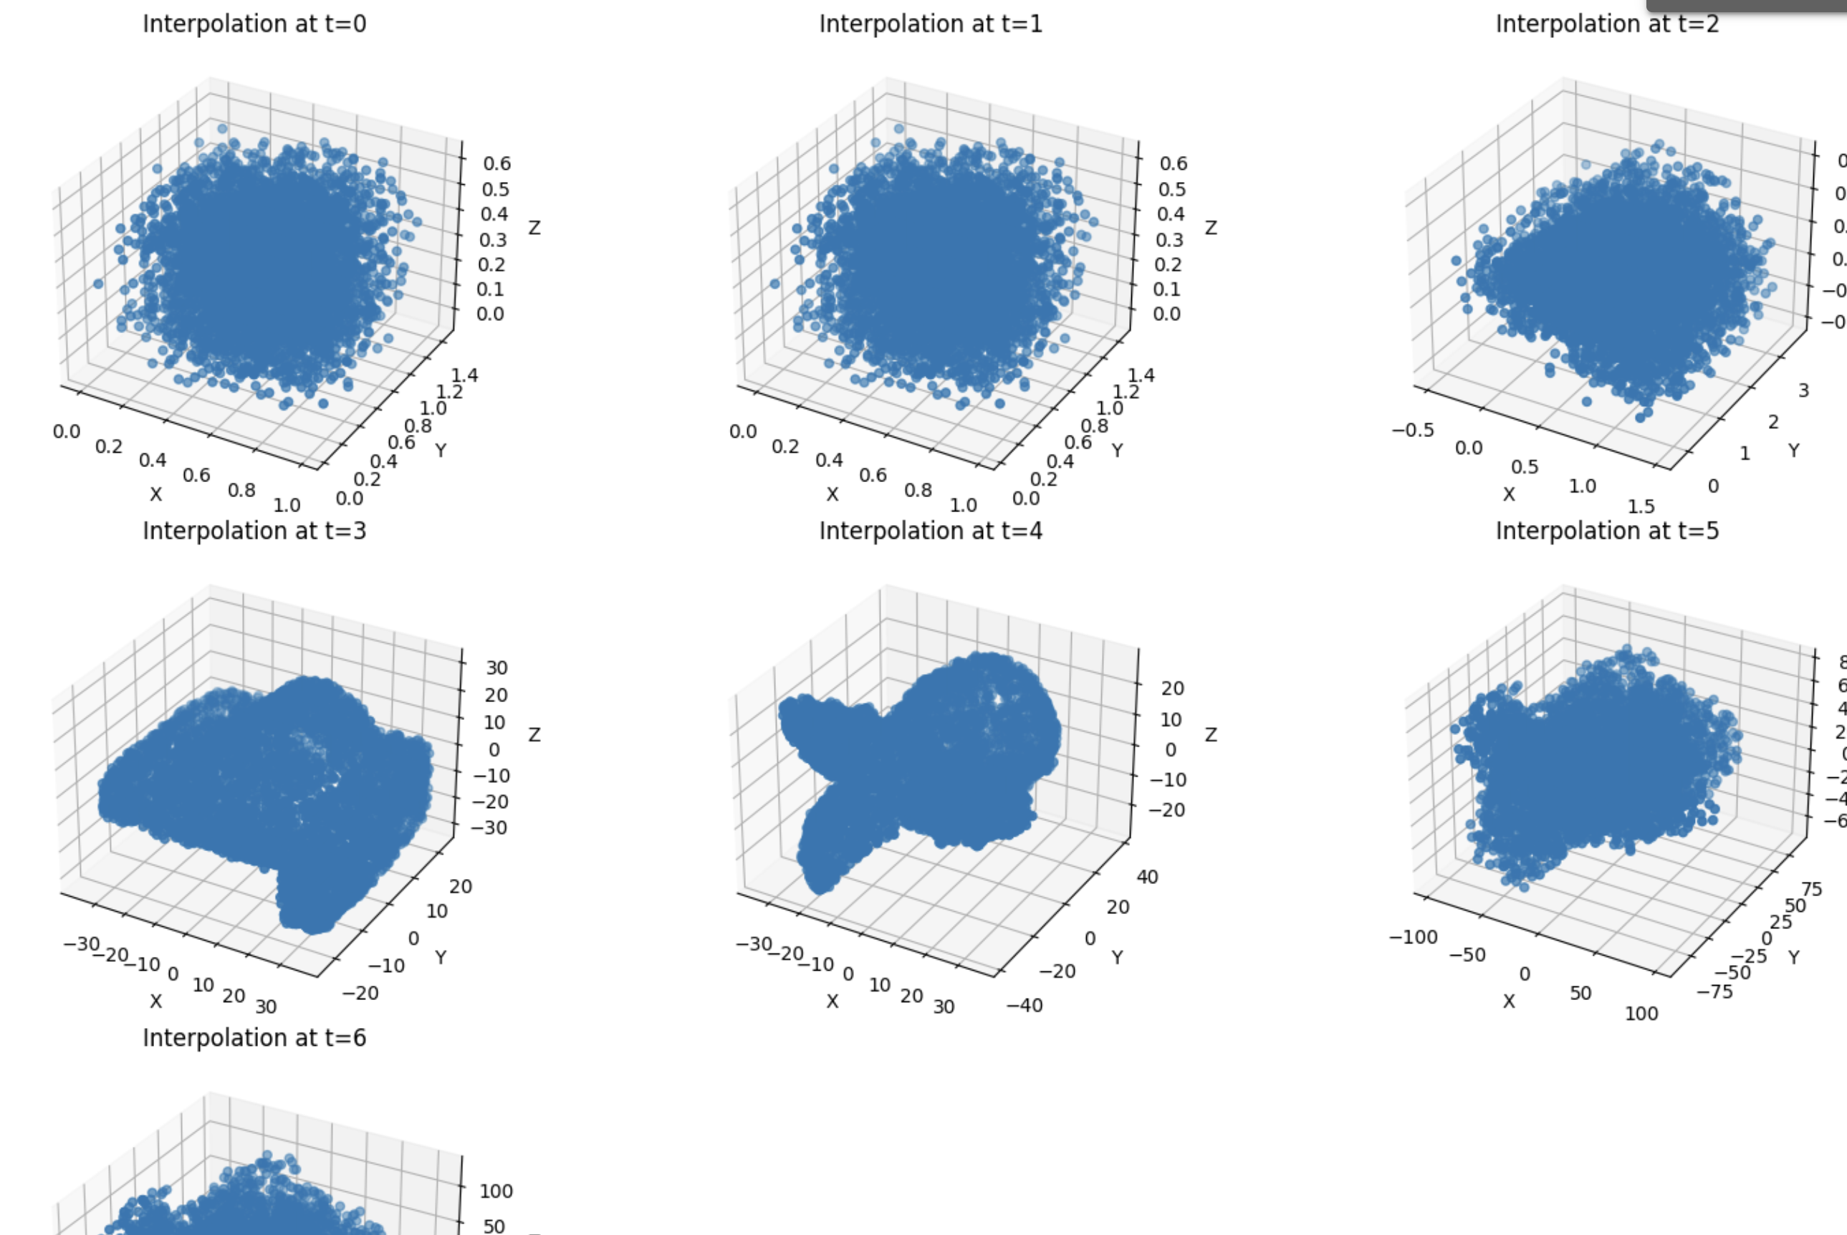
Part Two

Slide 9
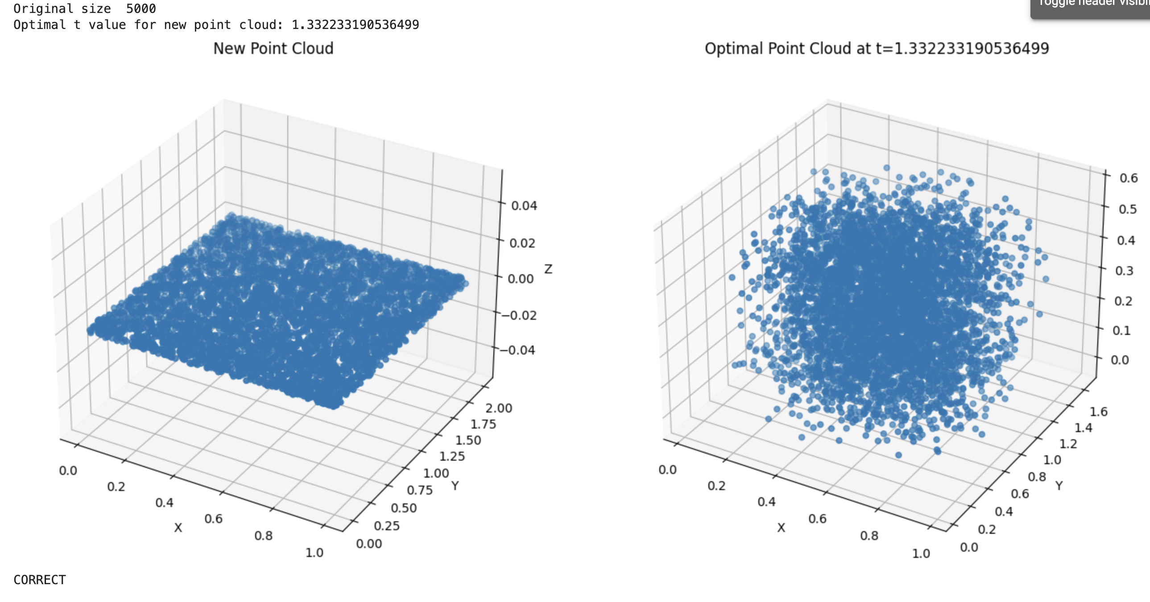
Part Three

Slide 10
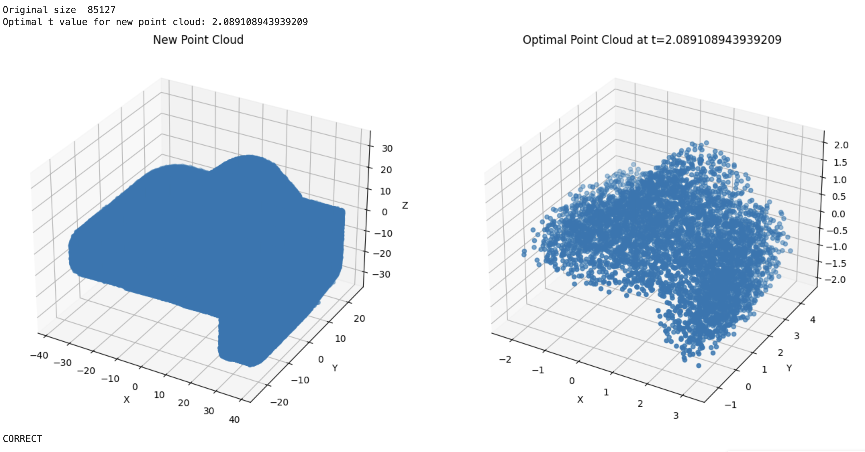

Slide 11
